Slide 1

Mental Health 4 All
Improving access, Saving lives
Team 3.12
Bridget Burke, RN
Marlissa Esquivel, BSN, RN, AMB-BC
Laura Velli, NP, PMHNP
May 16th, 2021
Notes:
Closing the gap in mental healthcare accessibility – one language at a time (just thought of this, don't love it but maybe something with these themes?)
Also our logo? Anyone have any cool ideas?

Slide 2
Imagine struggling with ongoing sadness, constant worries, and frequent crying spells, but because you do not speak English you cannot get help?
Team 3.12
Notes:
Notes: "thinking out loud" here –
- what if we said something like "Imagine struggling with overwhelming sadness and never ending worries, then seeking help from a licensed professional – only to be turned away because you do not speak English?"

Slide 3
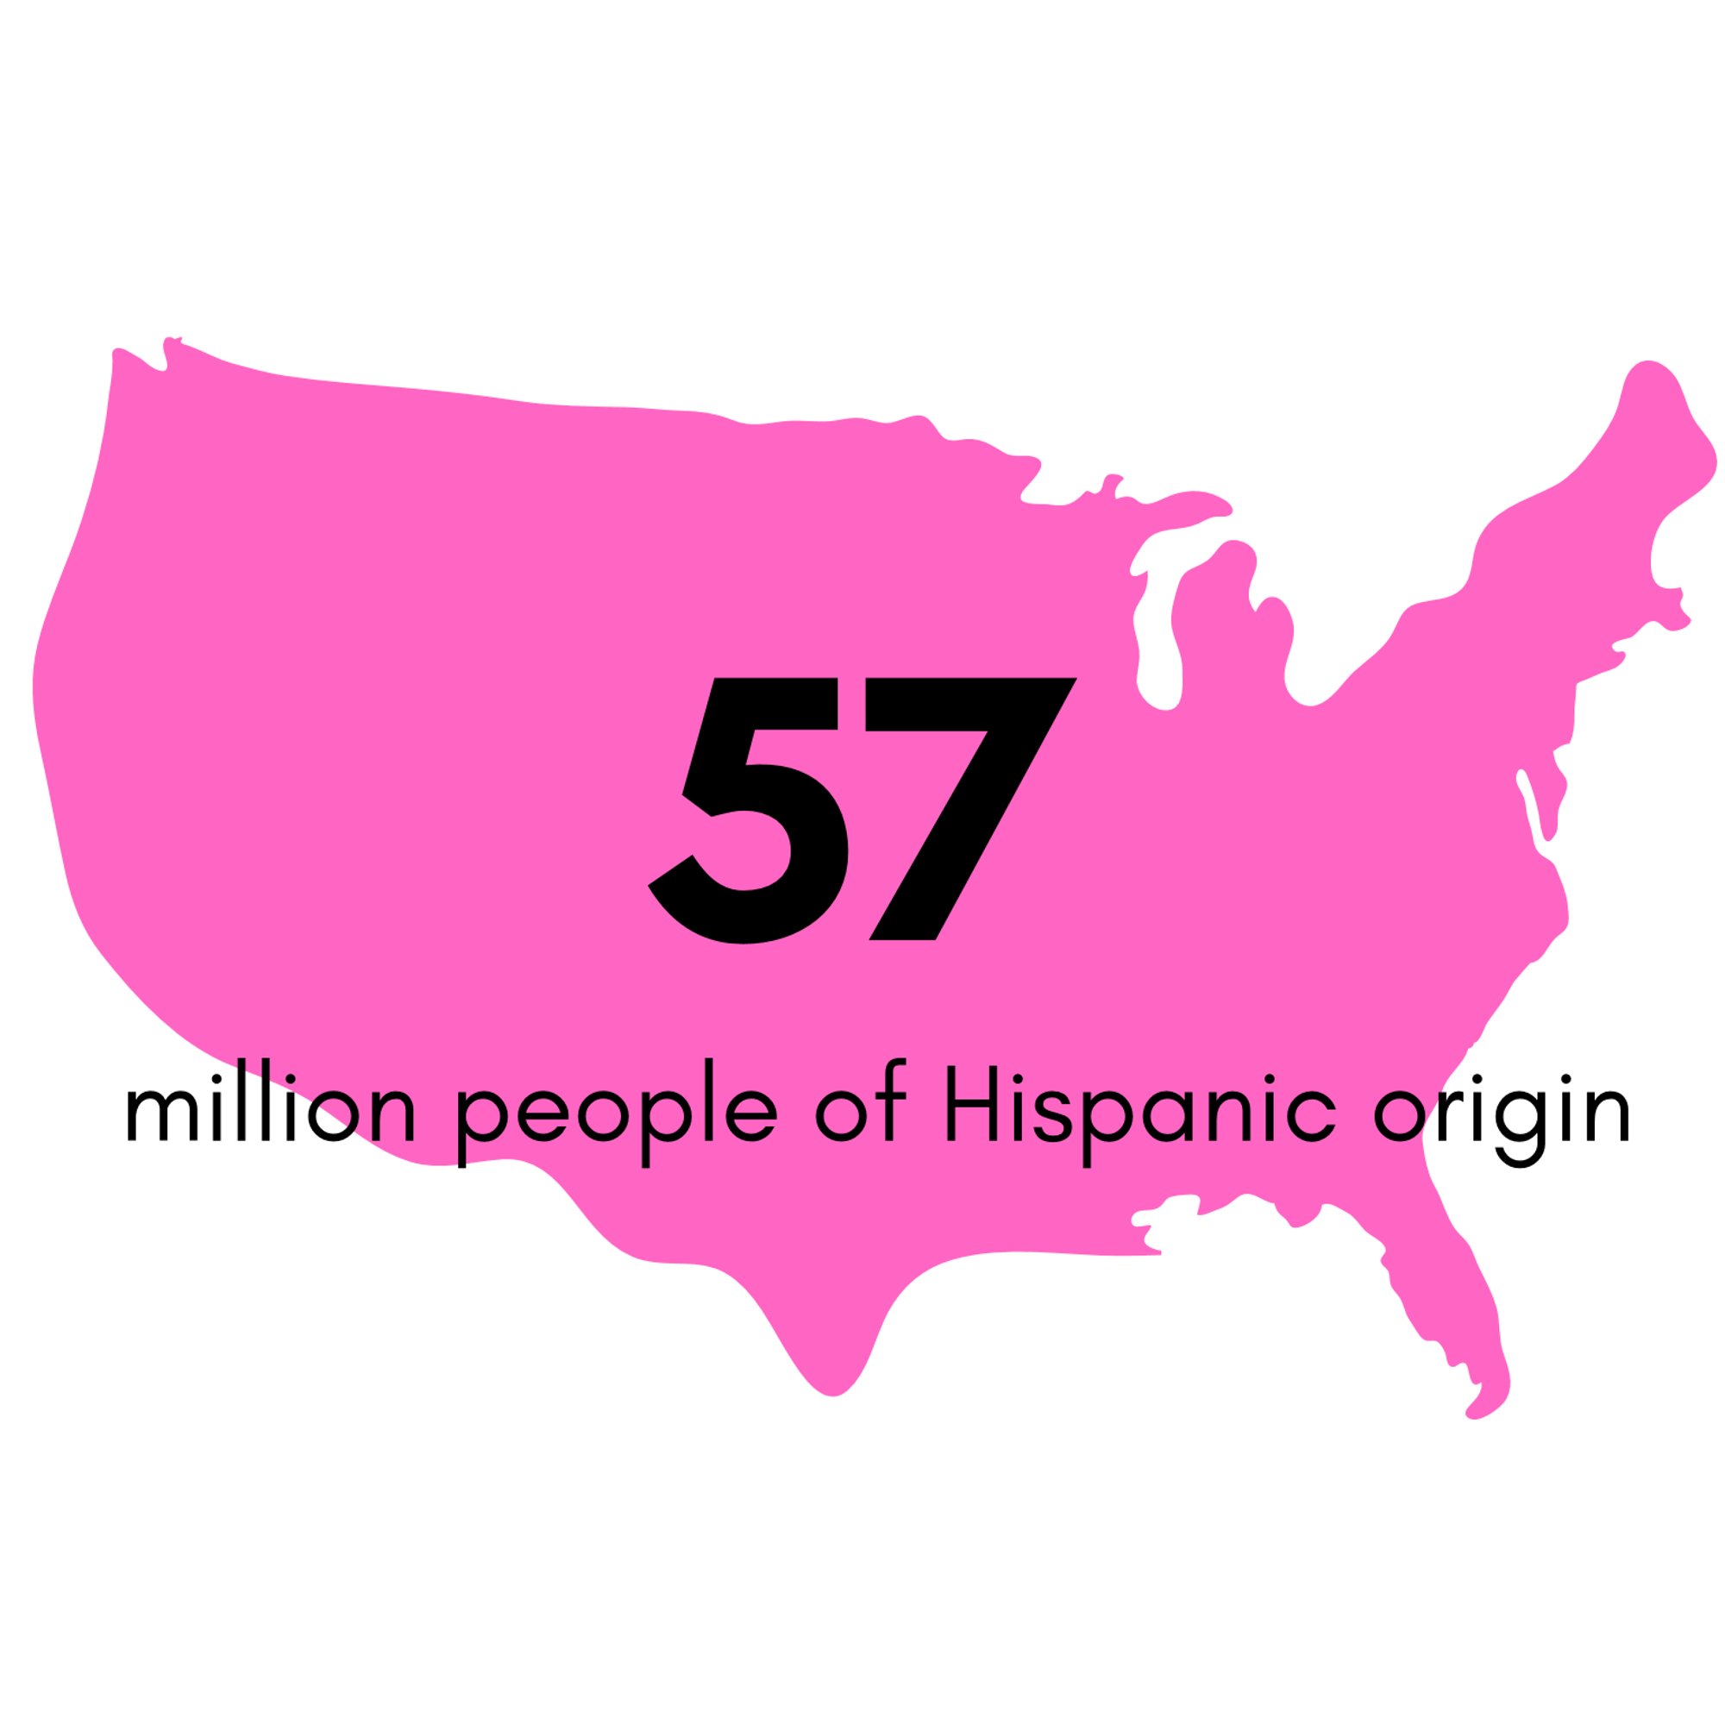
1 in 20
Team 3.12
Mental Illness Does Not Discriminate​
In 2019, 16 % of those of Hispanic origin reported mental illness
Hispanics receive services from a mental health specialist.
10 million Hispanics in the US identify their English proficiency as “not well” or “not well at all”
(Statista, 2021)
Notes:
Only 5% of therapists can provide services in Spanish and there are even fewer prescribers.
Only 5% of therapists can provide services in Spanish and there are even fewer prescribers.
Approximately 1 in 10 Hispanics with a mental disorder use mental health services from a general health care provider, while only 1 in 20 receive such services from a mental health specialist.

Slide 4
Why is addressing language barriers in mental health so important?
Team 3.12
Notes:
Language proficiency may be especially challenging in mental health treatment because psychiatric evaluation hinges on obtaining a thorough history, and because key symptoms are not reflected in directly observable behaviors or signs of morbidity and can be elicited only via self-report. Language barriers can prevent recognizing and labeling mental health problems and can interfere with successful communication about treatment needs and care options
Mental health assessment hinges on the psychiatric interview and obtaining a thorough patient history.
Key symptoms may not be observed directly or made apparent through physical assessment.
The patient's presenting problem can only be elicited through self-report.
What if there was a way English speaking mental health providers could communicate with Spanish speaking patients in real time?
We want to address improving access to mental health care for the Limited English Proficiency (LEP) Hispanic population in underserved communities.

Slide 5
SOLUTION
MENTAL HEALTH 4 ALL
Team 3.12
Web based telepsychiatry telemedicine platform which allows real time translation for telepsychiatry providers to communicate with Spanish speaking patients with anxiety
Notes:
We want to address improving access to mental health care for the Limited English Proficiency (LEP) Hispanic population in underserved communities.

Slide 6
THE PRODUCT
Team 3.12

Slide 7












Currently Available Teleheath Solutions
Team 3.12
Notes:
Significant inefficiencies for Spanish speakers trying to access psychiatric resources in the booming time of telepsych
** wondering what we should verbally say here?**

Slide 8

We are well positioned against "competition"
Team 3.12
BUILDING ON EXISTING API
COST CONTAINMENT
TIME
EASE OF USE
Notes:
WIN WIN WIN
LESS WORK FOR USER
MICROSOFT
Building on exisiting API services
Head start, agility, narrow scope
Specialty and depth
Glossary / added dictionary
NO WAIT OR MINIMAL
These aren't set in stone, but I was wondering if we could "categorize" what makes us better from the BUSINESS perspective ?
What do you guys think? Take a pass at anything

Slide 9

Scalability
Team 3.12
Incorporating Mental Health 4 All into established communication platforms.
App will initially be piloted to those with anxiety/depression to ensure that the medical terminology is accurate, and we will continue to make improvements to the translation API to expand to address other mental health concerns.
Notes:
Do you think we need a whole slide? Wondering if we could squeeze into the next one.

Slide 10

IMPLEMENTATION COST
First 5 audio hours: $1 per audio hour, then $2.50 per hour​
Cloud Storage: $0.0008 per GB ​
Programmer: $150,000 salary
Insurance reimbursement
HSA & FSA ​
Tiered payment options/income based monthly subscription
Team 3.12
Notes:
$150 per hour for an in person interpreter -->
KEY RESOURCES and PARTNERSHIPS
o options for in app translations
Telephonic language line services can be time consuming and cumbersome for providers
Long wait times for Spanish speaking providers
Improve access to mental health care by reducing wait times and cost of care
Similar to other competitetors utilize

Slide 11
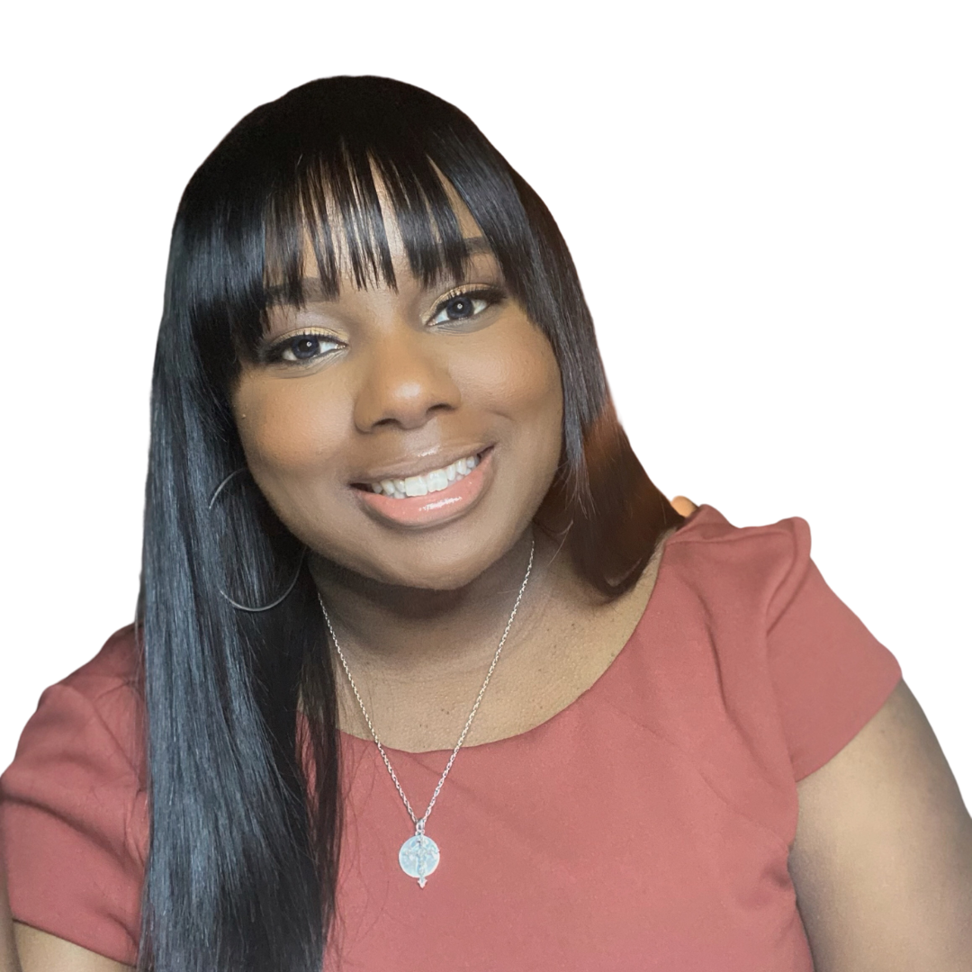
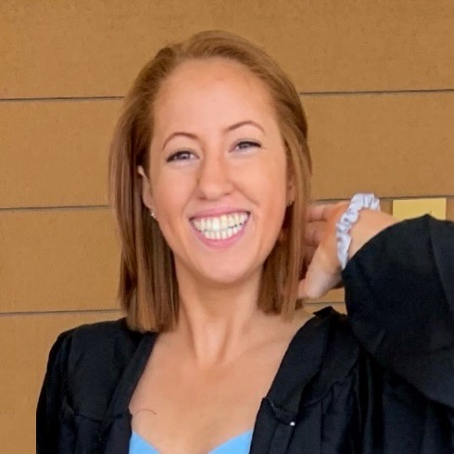
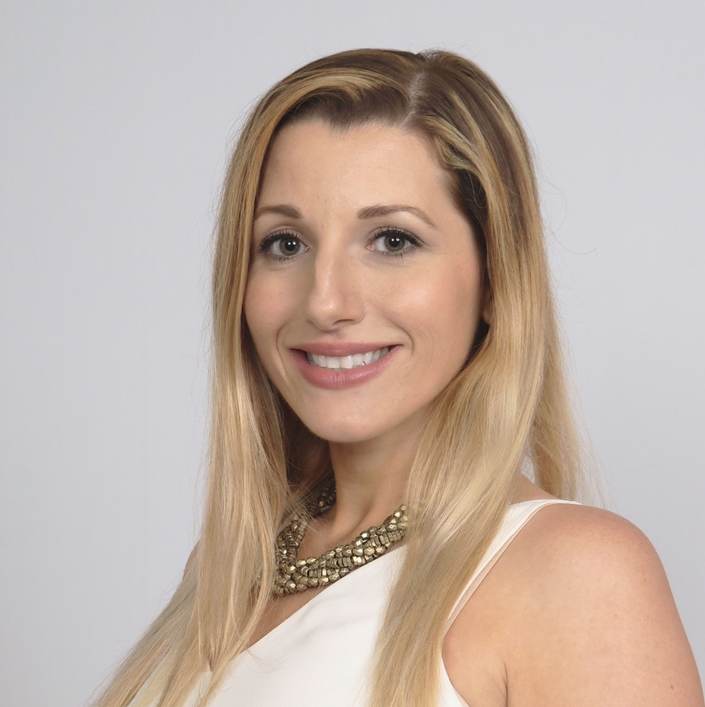
Our team has complementary skillsets and a passion for the space
Marlissa Esquivel, BSN, RN, AMB-BC
Laura Velli, NP, PMHNP
Bridget Burke, BSN, RN
Psychiatric Mental Health Nurse Practitioner
Master of Science In Psychiatric Nursing Vanderbilt University, 2016
Doctorate in Nursing Practice student, New York University
Ambulatory Care Nurse Manager for 15 specialty clinics in a large safety net hospital system in Texas.
Experienced & dedicated to improving access to care for those communities that are most vulnerable and underserved.
Co-Founder of nurse centric startup FiVana
Pediatric RN
Team 3.12

